Slide 2


Slide 3
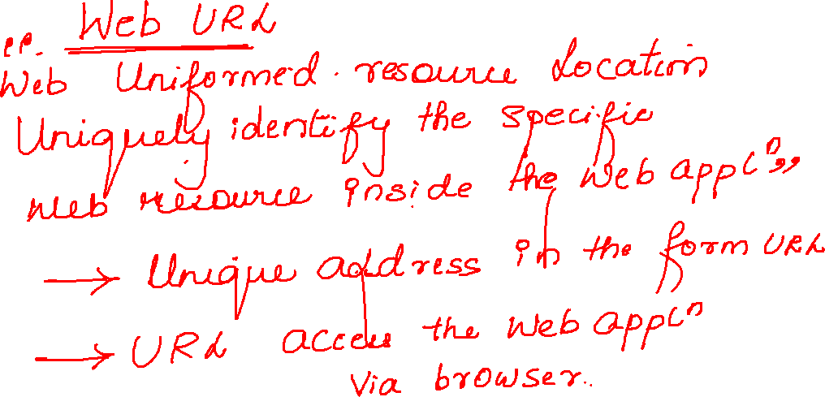

Slide 4

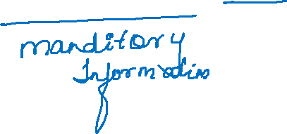
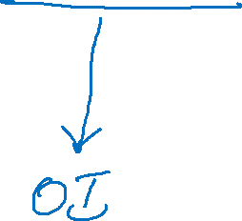



Slide 5
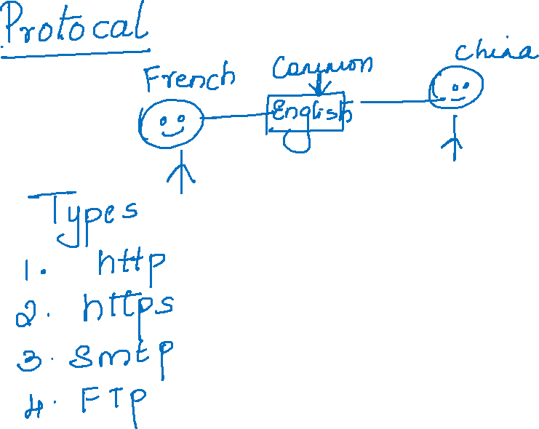


Slide 6
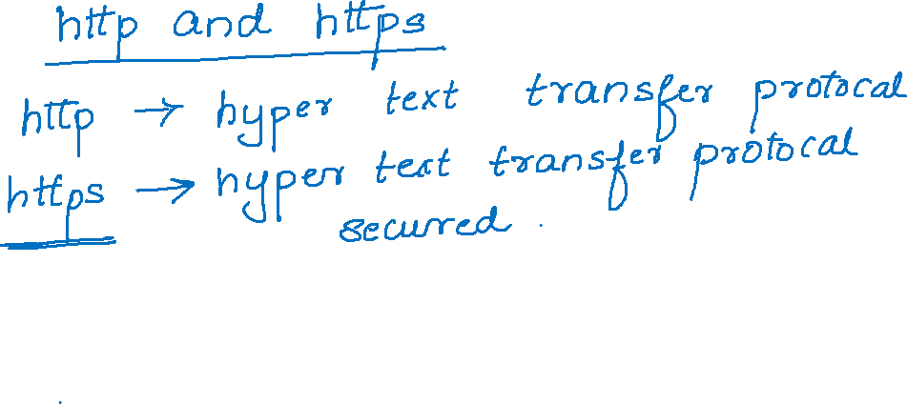
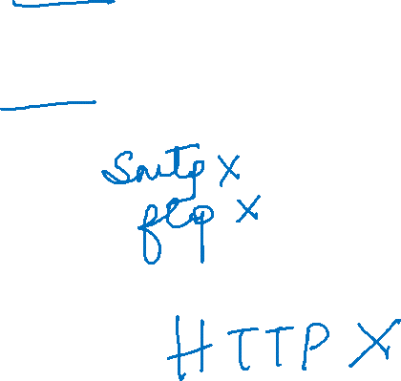

Slide 7
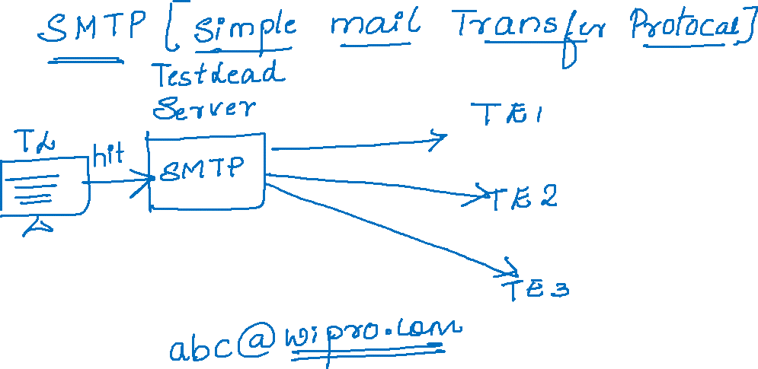

Slide 8
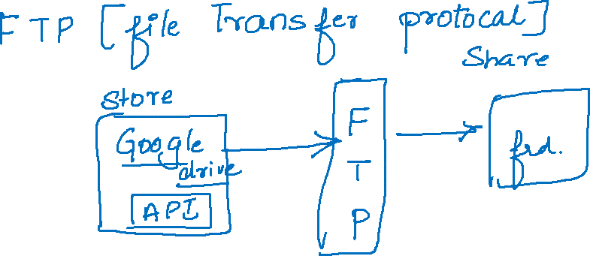
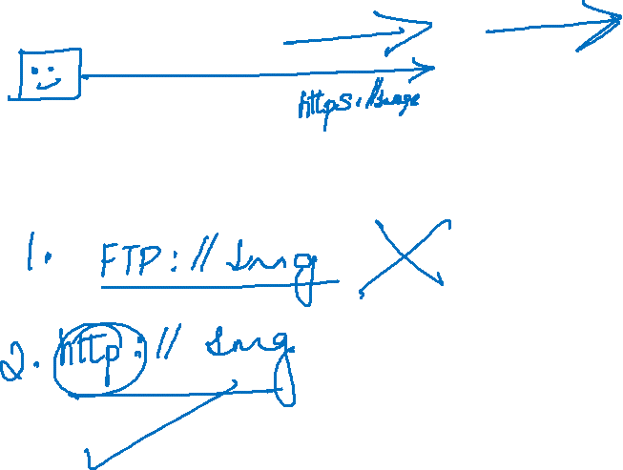

Slide 9


Slide 10


Slide 11
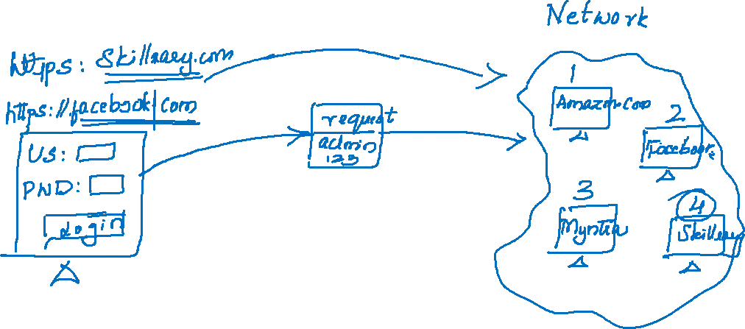

Slide 12


Slide 13

https://www.myntra.com/

Slide 14
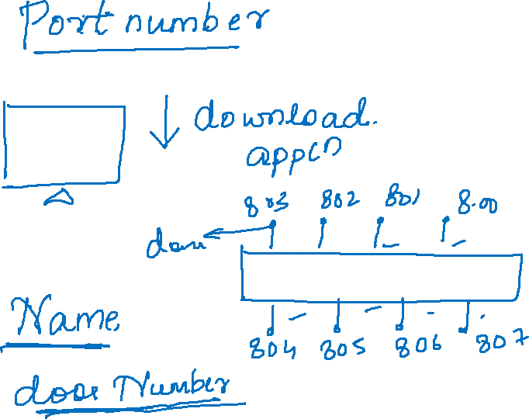

Slide 15
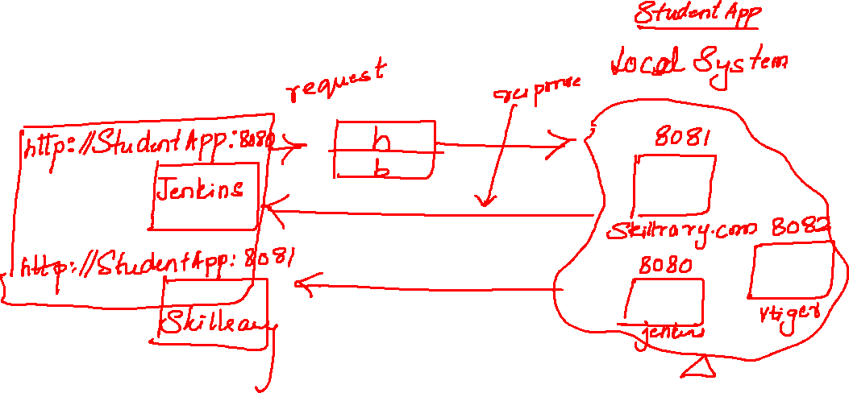

Slide 16
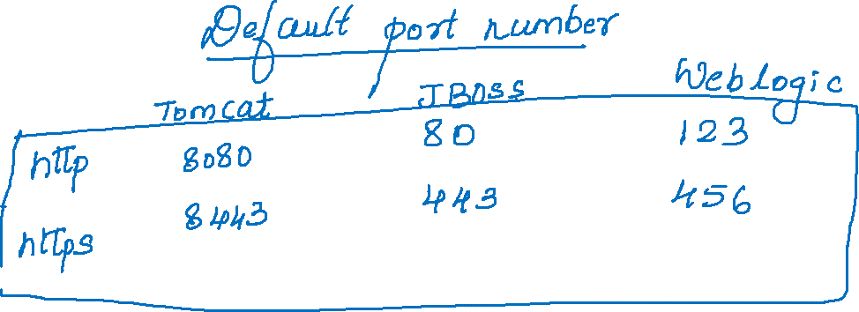

Slide 17
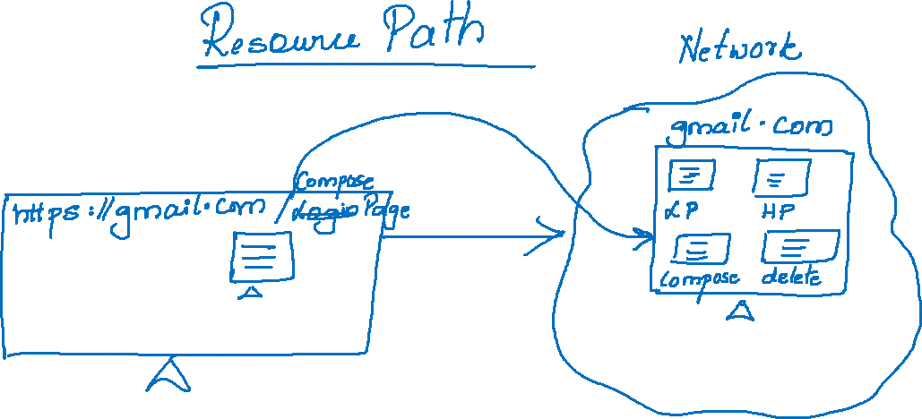

Slide 18
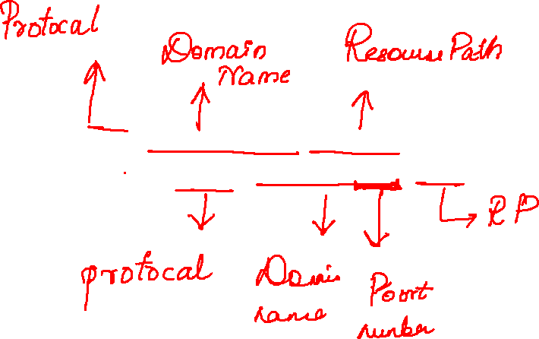
https://www.facebook.com/login/identify
http://localhost:8080/login

Slide 19
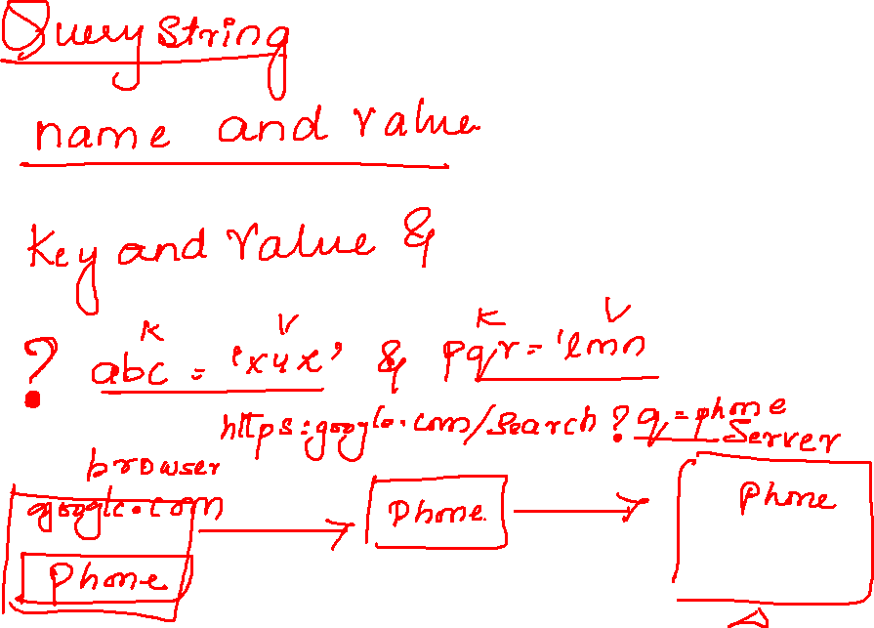

Slide 20

https://www.google.com/search?q=computer&sxsrf=ALeKk03a35kQV4SEIhaeeFhfLX4aKqh7TA%3A1629515448266&source=hp&ei=uG4gYZ

Slide 21


Slide 22
